Slide 1
Technological Developments
RAIN RFID Technology
01
Introduction
A brief introduction on Rain RFID technology, and how it works!
All Possible Futures with Limitless Applications!

Slide 2
01
RAIN RFID Technology
RAIN RFID is a technology that uses small, wireless tags to track and identify items automatically without needing batteries or direct scanning. It helps businesses manage inventory, track assets, and improve efficiency by connecting physical objects to the digital world.
Introduction
A brief introduction on Rain RFID technology, and how it works!

Slide 3


Introduction
Why Is It Called RAIN RFID?
RAIN RFID Technology
RAIN RFID is a technology that uses small, wireless tags to track and identify items automatically without needing batteries or direct scanning. It helps businesses manage inventory, track assets, and improve efficiency by connecting physical objects to the digital world.
RAIN RFID gets its name from combining the word RFID (Radio Frequency Identification) with the idea of connecting items to the cloud (Essentially similar to how rain is connected to the cloud in real life!) . The name emphasizes how the technology allows data about physical items to flow seamlessly to cloud-based systems for tracking, identification, and management.

Slide 4
Introduction
Why Is It Called RAIN RFID?
RAIN RFID gets its name from combining the word RFID (Radio Frequency Identification) with the idea of connecting items to the cloud (Essentially similar to how rain is connected to the cloud in real life!) . The name emphasizes how the technology allows data about physical items to flow seamlessly to cloud-based systems for tracking, identification, and management.

Slide 5


Introduction
Line-of-Sight
Limited Data Storage
Need to be scanned directly by a reader, requiring a clear line of sight. This limits efficiency in environments where items are stacked or obscured.
Superior To The Barcode!
Can store only a small amount of data (typically 20-25 characters)
Currently, barcodes remain the primary method for identifying items in warehouses, stores, and other environments. While they serve their purpose in mass identification, they are far from perfect. In fact, barcodes come with numerous limitations that significantly hinder efficiency and accuracy in modern operations.
Easily Damaged
Single-Item Scanning
Can become unreadable if they are scratched, smudged, torn, or printed poorly, which can disrupt operations.
Can only be scanned one at a time, therefore being very inefficient and slow!
Manual Tracking
Counterfeiting
Barcodes do not support real-time updates or tracking. They require manual scanning to update information
Barcodes are relatively easy to duplicate, which can lead to security and authenticity concerns

Slide 6
Limitations of The Barcode!
Line-of-Sight
Limited Data Storage
Main Components
Need to be scanned directly by a reader, requiring a clear line of sight. This limits efficiency in environments where items are stacked or obscured.
Can store only a small amount of data (typically 20-25 characters)
Now to better understand how Rain RFID technology works, it’s best to understand the main components at play, and how they all fit together to create such a powerful system, which has limitless potential uses
Easily Damaged
Single-Item Scanning
Can become unreadable if they are scratched, smudged, torn, or printed poorly, which can disrupt operations.
Can only be scanned one at a time, therefore being very inefficient and slow!
Manual Tracking
Counterfeiting
Barcodes do not support real-time updates or tracking. They require manual scanning to update information
Barcodes are relatively easy to duplicate, which can lead to security and authenticity concerns

Slide 7
Main Components
The Main Components of Rain RFID Technology
Now to better understand how Rain RFID technology works, it’s best to understand the main components at play, and how they all fit together to create such a powerful system, which has limitless potential uses

Slide 8
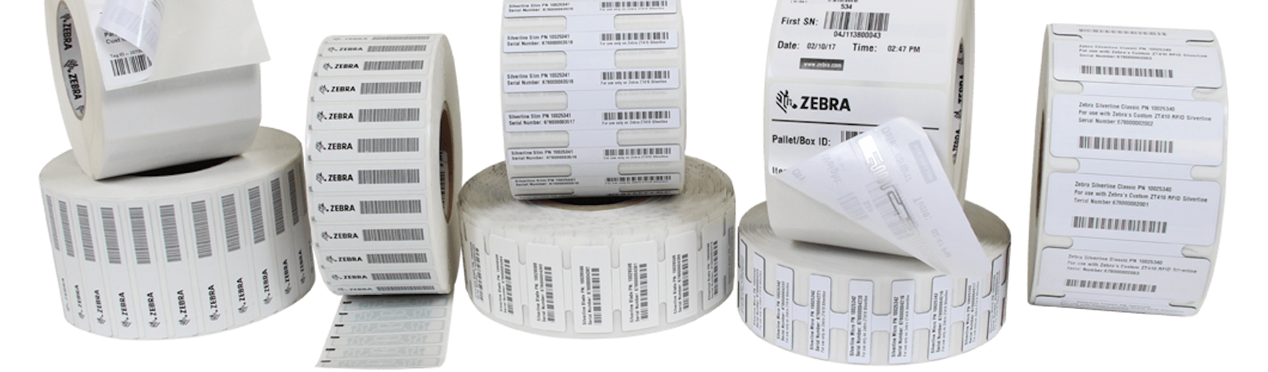
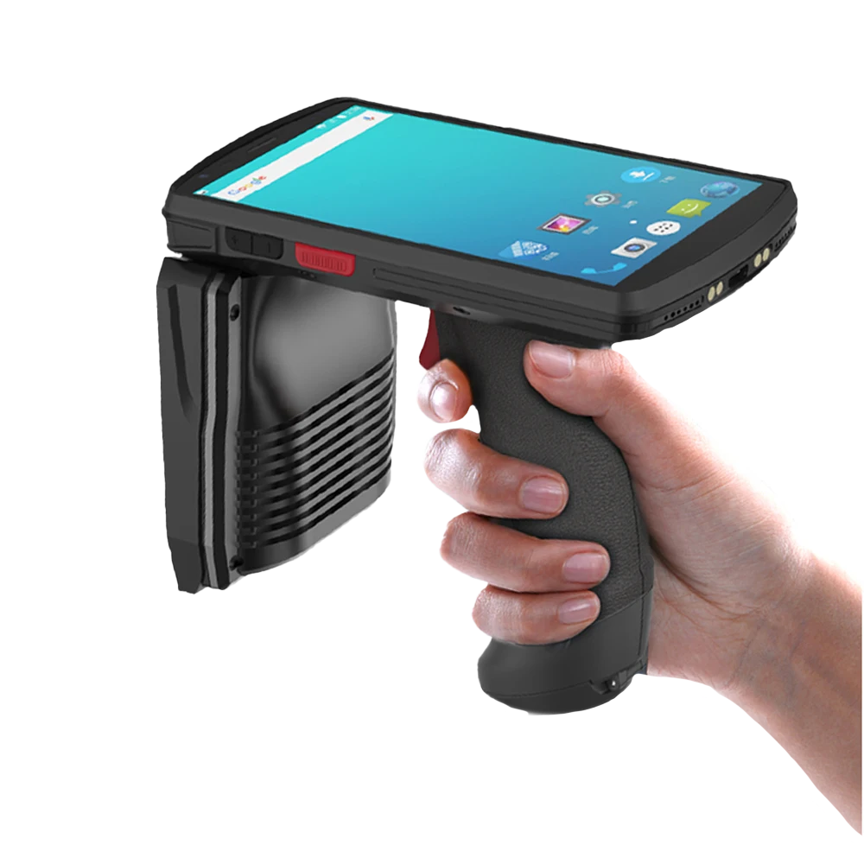
Components
Tags
Rain RFID tags are eco-friendly labels equipped with a tiny chip and antenna that receive energy from radio waves emitted by a Rain RFID reader. They use this energy to wirelessly transmit the tag’s information back to the reader, all without requiring direct line-of-sight

Slide 9


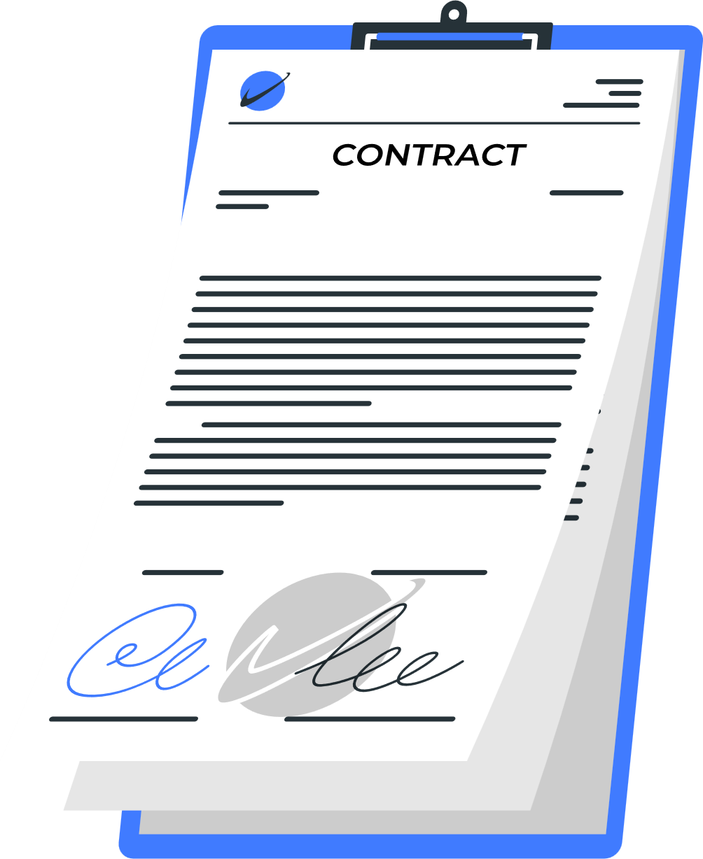
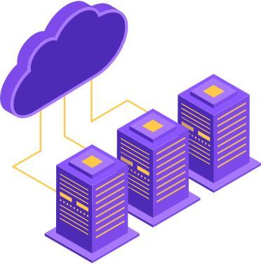
Components
Rain RFID Reader
Rain RFID readers are devices, which typically come in the form of a phone attached to a radio wave antenna. These readers emit radio waves to power and communicate with Rain RFID tags, the tags then bounce the waves back to the reader with it’s ID number, enabling the wireless capture of the tag’s data from a distance without direct line-of-sight.

Slide 10
Components
Cloud Management System
Cloud systems are the core of the Rain RFID ecosystem, linking the ID of an RFID tag read by an RFID reader to its associated data. Without them, tags are just meaningless IDs, but the cloud brings meaning to these IDs associating them to images, datasets, text files, contracts, and more.

Slide 11
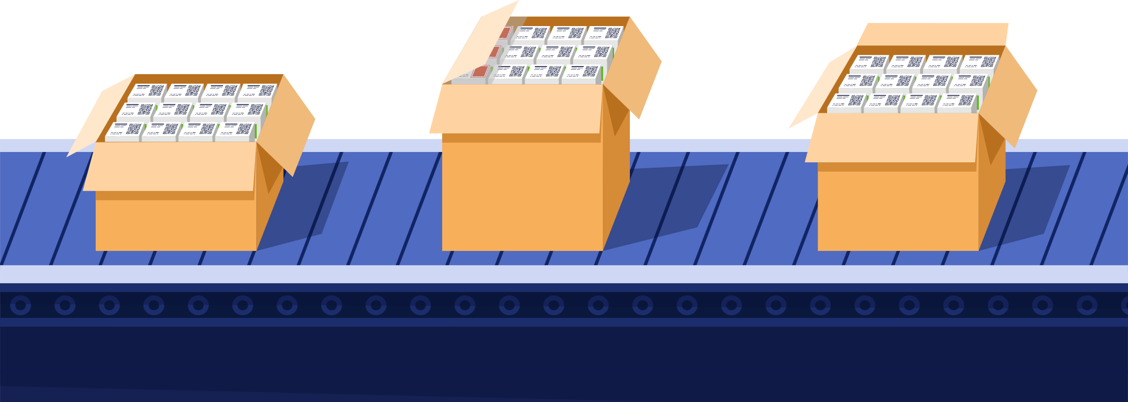

A New Day In The Factory

Slide 12
A New Day In The Factory
10 m
Here we have a situation, where a factory insector wants to check the expiration date on all of the units within the box. Each unit has a Rain RFID tag attached to it!

Slide 13
A New Day In The Factory
All the inspector needs to do is point and shoot at the box from a distance, and just like that, all the units’ RFID tags within the box have been read, and their IDs have been registered on the reader.

Slide 14
A New Day In The Factory
The Cloud Management system processes tag IDs in milliseconds, cross-referencing them against a comprehensive product database. This allows it to instantly identify the associated objects and determine their status, such as checking for expired items, by matching the IDs with stored product information.

Slide 15
A New Day In The Factory
After millisecond processing speeds, the cloud would then return the results queried, and all items within the box are found to be good, and ready to be shipped!

Slide 16

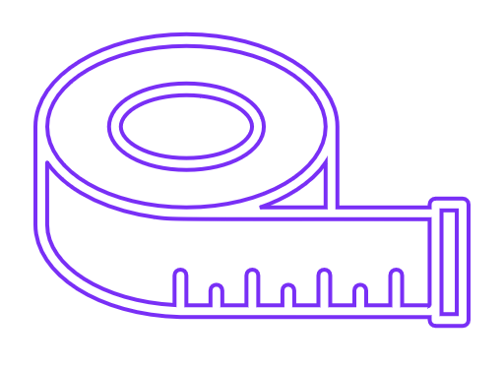

High Capacity and Speed
Long Range
Rain RFID scanners can read up to 1,000 tags per second, and can hypothetically store megabytes of data per tag
Tags can be read from several meters away
Milliseconds
Immutable
Real-Time Data
Tags are difficult to duplicate and can be embedded with encryption for integrity!
RFID technology claims near-perfect accuracy in identifying tagged items
With the right system in place, this entire process would happen in an instant!
High Durability
Cost Effective
Tags come in a variety of different materials that can stand many harsh environments
Their costs have significantly decreased, making them highly cost-effective.

Slide 17
High Capacity and Speed
Long Range
99.999%
Rain RFID scanners can read up to 1,000 tags per second, and can hypothetically store megabytes of data per tag
Tags can be read from several meters away
Immutable
Real-Time Data
Rain RFID technology can help organizations reach an accuracy upwards of!
Tags are difficult to duplicate and can be embedded with encryption for integrity!
RFID technology claims near-perfect accuracy in identifying tagged items
High Durability
Cost Effective
Tags come in a variety of different materials that can stand many harsh environments
Their costs have significantly decreased, making them highly cost-effective.

Slide 18
We will now take a peak around the world, and see who’s using RAIN RFID technology, and how it’s helped them to succeed!
Rain RFID Capabilities
02
High Capacity and Speed
Long Range
Applications of Success
Rain RFID scanners can read up to 1,000 tags per second, and can hypothetically store megabytes of data per tag
Tags can be read from several meters away
Immutable
Real-Time Data
Tags are difficult to duplicate and can be embedded with encryption for integrity!
RFID technology claims near-perfect accuracy in identifying tagged items
High Durability
Cost Effective
Tags come in a variety of different materials that can stand many harsh environments
Their costs have significantly decreased, making them highly cost-effective.

Slide 19
02
Applications of Success
We will now take a peak around the world, and see which successful companies have been using RAIN RFID technology, and how it’s helped them to succeed!

Slide 20

Applications of Success
World Wide Adoption
Thanks to the numerous features and advantages of RAIN RFID technology, companies are increasingly recognizing its potential and gradually integrating it into their daily operations. Here are some of the impressive results they've achieved:

Slide 21

Airlines & Travel
Delta Airways
In 2022, Delta Air Lines has successfully deployed it’s RFID technology to enable hands-free scanning of baggage throughout the handling process. It’s the first carrier to fully integrate RFID within its operations.
Overall They’ve encountered a resounding success as they’re accuracy rates for tracking Luggage is between 99 – 100%!
(Source: RFID Journal)

Slide 22

Healthcare
Johnson & Johnson
Johnson & Johnson leverages RFID technology to efficiently manage surgical instruments and medical supplies, enhancing both operational efficiency and patient safety.
The implementation delivered exceptional results, achieving 100% stock availability, ensuring critical supplies were always on hand.
(Source: SupplyChain Brain)
(Source: Identimedical)

Slide 23

Manufacturing
BMW
BMW relies on a Just-in-Time (JIT) manufacturing processes, requiring parts to be in the right place at the right time. They’ve implemented an RFID system which tracks the movement and location of parts, providing an instant view of their position within the logistics chain.
Successfully, The RFID system gave BMW real-time stillage tracking, reducing delays and enabling proactive maintenance for smoother operations.
(Source: Core rfid)

Slide 24

Events
03
Qatar World Cup 2022
The Rain Alliance
RAIN RFID technology was employed during the world cup 2022 to manage attendee access and monitor crowd movements. In collaboration with Impinj created a system which facilitated efficient entry and exit across all eight stadiums. This enabled real-time crowd monitoring and enhanced security measures.
Overall the system was a success! Achieved an accuracy exceeding 98%, facilitating the smooth exit of up to 6,000 fans per hour through each of the 167 egress gates.
Exploring the Rain Alliance, their contribution to the world’s Rain RFID infrastructure, and how they’re powering the future
(Source: Cisper)

Slide 25

03
The Rain Alliance
Exploring the Rain Alliance, their contribution to the world’s Rain RFID infrastructure, and how they’re powering the future

Slide 26

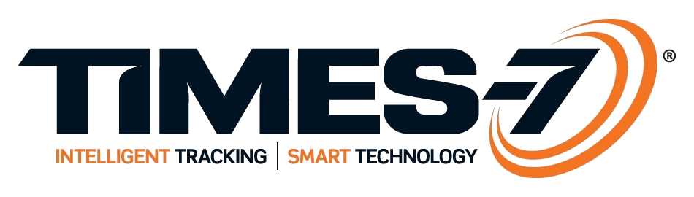




Decathlon
Times-7
A leading global sporting goods retailer offering a wide range of sports equipment and apparel.
A New Zealand-based company designing and manufacturing ultra-low profile RFID antennas.
Michelin
Arizon RFID Technology
The Rain Alliance
A renowned French tire manufacturer known for producing high-quality tires for various vehicles.
A Chinese company focusing on the development and production of RFID tags and related technologies.
The RAIN Alliance is a global organization dedicated to advancing the adoption and development of RAIN RFID technology. The alliance unites technology providers, manufacturers, system integrators, and end-users to collaborate on establishing the standards and innovation.
Voyantic
EM Microelectronic-Marin
A company specializing in measurement and testing solutions for RFID and NFC technologies.
A Swiss semiconductor manufacturer specializing in ultra-low-power integrated circuits and RFID products.
Zebra Technologies
NXP Semiconductors
An American corporation providing enterprise asset intelligence solutions, including barcode scanners and RFID technologies.
A subsidiary of NXP Semiconductors, offering RFID and NFC solutions for various applications.

Slide 27
Decathlon
Times-7
A leading global sporting goods retailer offering a wide range of sports equipment and apparel.
A New Zealand-based company designing and manufacturing ultra-low profile RFID antennas.
160
Michelin
Arizon RFID Technology
A renowned French tire manufacturer known for producing high-quality tires for various vehicles.
A Chinese company focusing on the development and production of RFID tags and related technologies.
Voyantic
Active corporate members of the Rain Alliance Group
EM Microelectronic-Marin
A company specializing in measurement and testing solutions for RFID and NFC technologies.
A Swiss semiconductor manufacturer specializing in ultra-low-power integrated circuits and RFID products.
Zebra Technologies
NXP Semiconductors
An American corporation providing enterprise asset intelligence solutions, including barcode scanners and RFID technologies.
A subsidiary of NXP Semiconductors, offering RFID and NFC solutions for various applications.

Slide 28

Core Members
Decathlon
Times-7
A leading global sporting goods retailer offering a wide range of sports equipment and apparel.
A New Zealand-based company designing and manufacturing ultra-low profile RFID antennas.
Michelin
Arizon RFID Technology
Siemens
A renowned French tire manufacturer known for producing high-quality tires for various vehicles.
A Chinese company focusing on the development and production of RFID tags and related technologies.
A German multinational conglomerate specializing in industrial automation, digitalization, and electrification solutions.
Voyantic
EM Microelectronic-Marin
A company specializing in measurement and testing solutions for RFID and NFC technologies.
A Swiss semiconductor manufacturer specializing in ultra-low-power integrated circuits and RFID products.
Zebra Technologies
NXP Semiconductors
An American corporation providing enterprise asset intelligence solutions, including barcode scanners and RFID technologies.
A subsidiary of NXP Semiconductors, offering RFID and NFC solutions for various applications.

Slide 29
Siemens
A German multinational conglomerate specializing in industrial automation, digitalization, and electrification solutions.

Slide 30
$250 Billion
Is the estimated net worth collectively of the Rain Alliance Group, with companies such as Siemens, Zebra, and NXP Semiconductors having the largest market cap

Slide 31
Collective Innovation
Their unified goal is to enhance efficiency, optimize supply chain operations, reduce waste, and enable smarter, more sustainable Rain RFID systems across diverse industries worldwide, ensuring that this technology remains a future-proof solution in all forms in many different industries

Slide 32

Top RFID Providers
Zebra
IMPINJ
Renowned for reliable, high-quality RAIN RFID technology, the company excels as being the #1 in the world for quality, in tracking, identification, and logistics solutions, driven by strong R&D and a global presence.
The second-largest player in the RFID market, providing solutions to industries like healthcare, aviation, retail, and more, with a global presence across the Americas, Europe, Asia-Pacific, the Middle East, and Africa.

Slide 33
Top Providers
04
Bringing It Here
Zebra
IMPINJ
How this technology can be brought to Saudi Arabia and potentially create a huge lucrative industry!
Renowned for reliable, high-quality RAIN RFID technology, the company excels as being the #1 in the world for quality, in tracking, identification, and logistics solutions, driven by strong R&D and a global presence.
The second-largest player in the RFID market, providing solutions to industries like healthcare, aviation, retail, and more, with a global presence across the Americas, Europe, Asia-Pacific, the Middle East, and Africa.

Slide 34





04
Vision 2030
Saudi Arabia is making strides to become a key player in various industries, with notable advancements and innovations underway. The technology sector, in particular, is poised to play a significant role in setting the Kingdom apart from other nations.
Bringing It Here
How this technology can be brought to Saudi Arabia and potentially create a huge lucrative industry!

Slide 35



Vision 2030
Saudi Arabia is making strides to become a key player in various industries, with notable advancements and innovations underway. The technology sector, in particular, is projected to play a significant role in setting the Kingdom apart from other nations.

Slide 36




Vision 2030 Goals
Vision 2030 aims to target many different sectors within the kingdom, and to kickstart many initiatives, however there are two main Initiatives in particular which focus on the technological development side of the country

Slide 37
Cloud First Policy
Focuses on moving government IT systems to cloud-based solutions to improve efficiency, innovation, and flexibility while reducing costs. It supports better communication between government entities, enhances cybersecurity, and ensures all government data is securely stored within Saudi Arabia
(Source: Gov.sa)

Slide 38
Digital Economy Policy
Aims to strengthen Saudi Arabia’s digital infrastructure to support economic growth and innovation. By promoting better access to government services, encouraging the use of digital technologies in businesses, and creating opportunities for jobs and skill development in the digital sector
(Source: Gov.sa)

Slide 39
The Rain Revolution
With its vast potential applications, Rain RFID technology could be the driving force propelling Saudi Arabia toward achieving its Vision 2030 technological goals. This transformative innovation has the power to elevate industries across the board, setting a new gold standard in service quality and operational efficiency while unlocking unprecedented possibilities for growth and excellence.

Slide 40
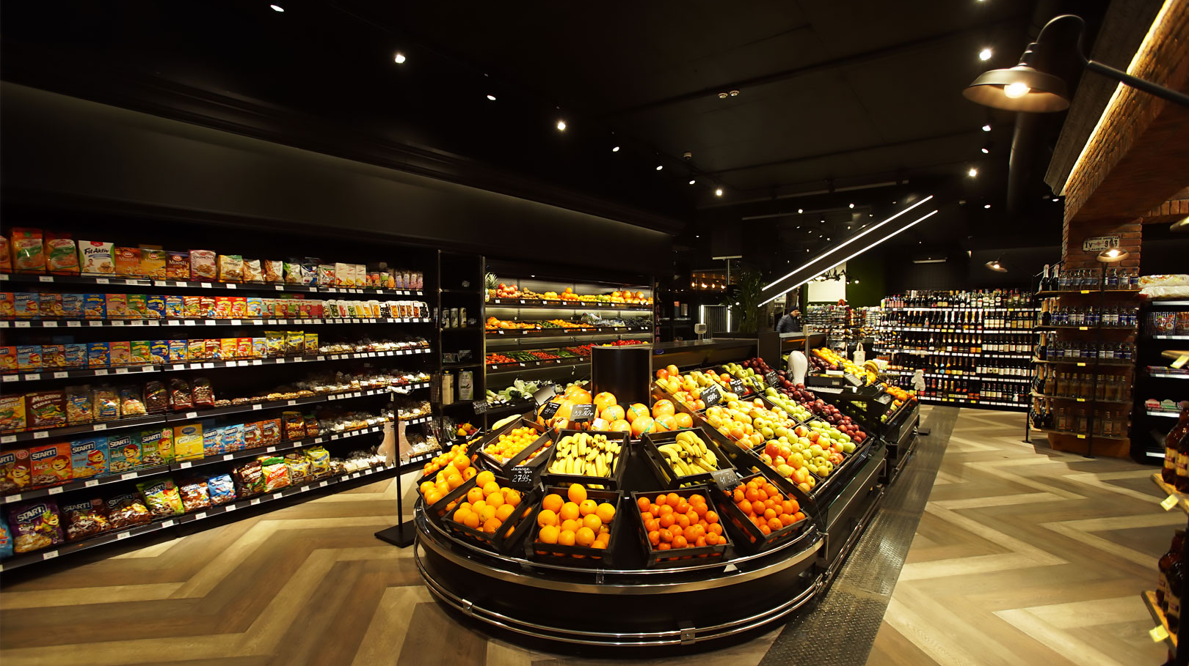
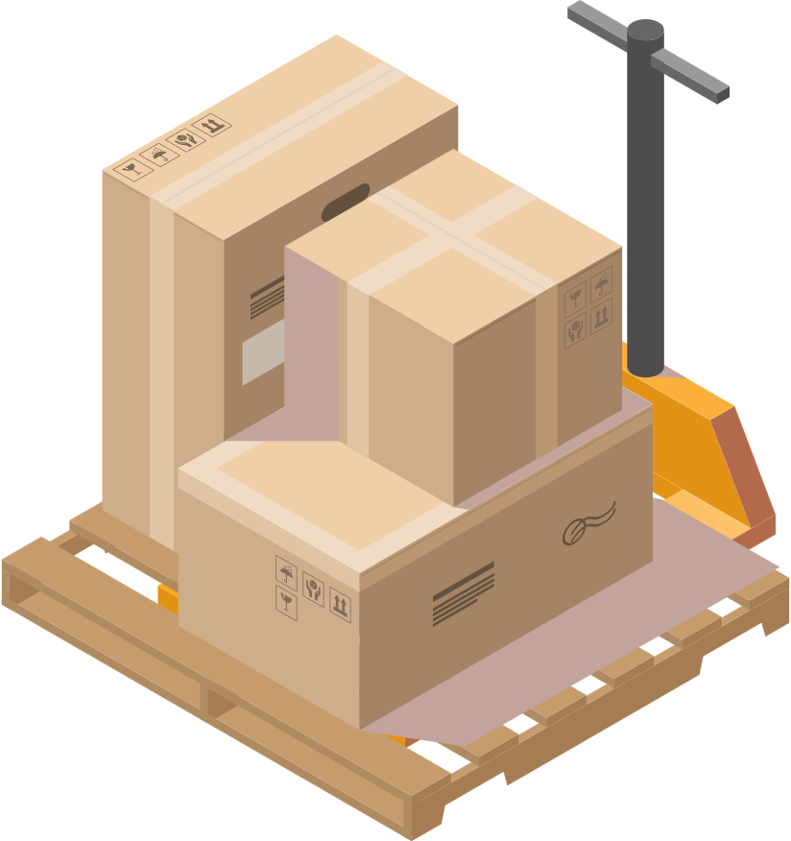
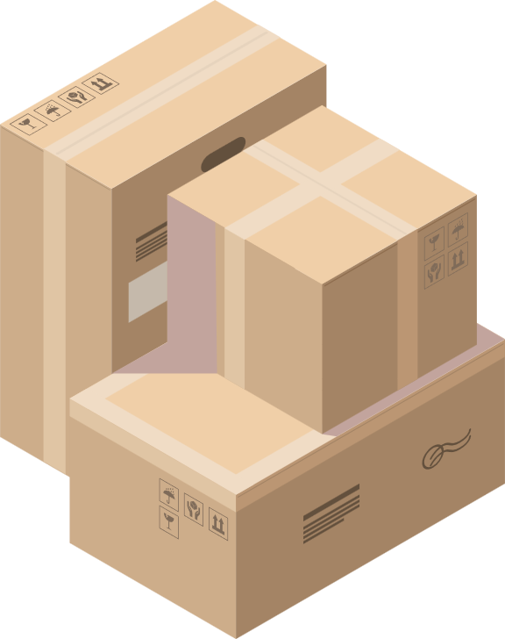
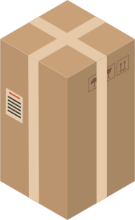
Retail

Slide 41
Inventory Management
With Rain RFID technology, Retail stores will be able to completely automate their stock tracking to achieve near-perfect accuracy and achieve new levels of sorting. With abilities such as detecting expired goods without any manual labor required

Slide 42

Healthcare

Slide 43

Streamlining Patients
Equipping patients with RFID bracelets streamlines the allocation process by efficiently matching them with the most suitable doctors. This ensures that patients receive timely care while optimizing resources, minimizing delays, and maximizing efficiency in healthcare delivery

Slide 44



Medication Inventory
Maintain near-perfect inventory accuracy through continuous tracking, and leverage automated inventory management systems to streamline the reordering process, ensuring that hospitals are always stocked with the necessary medications to treat patients effectively.

Slide 45

Aviation

Slide 46

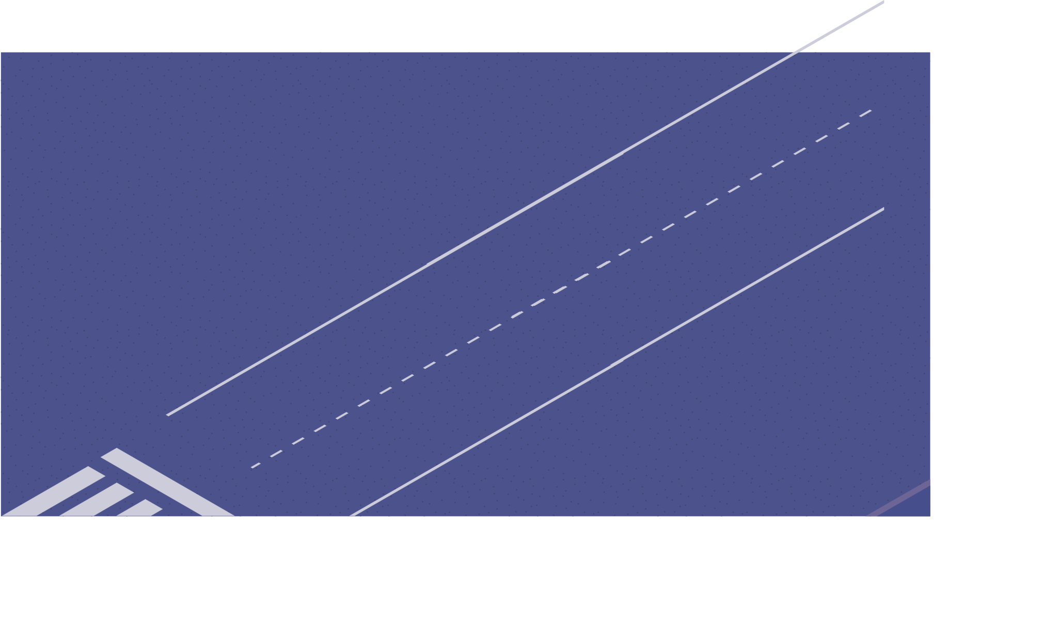

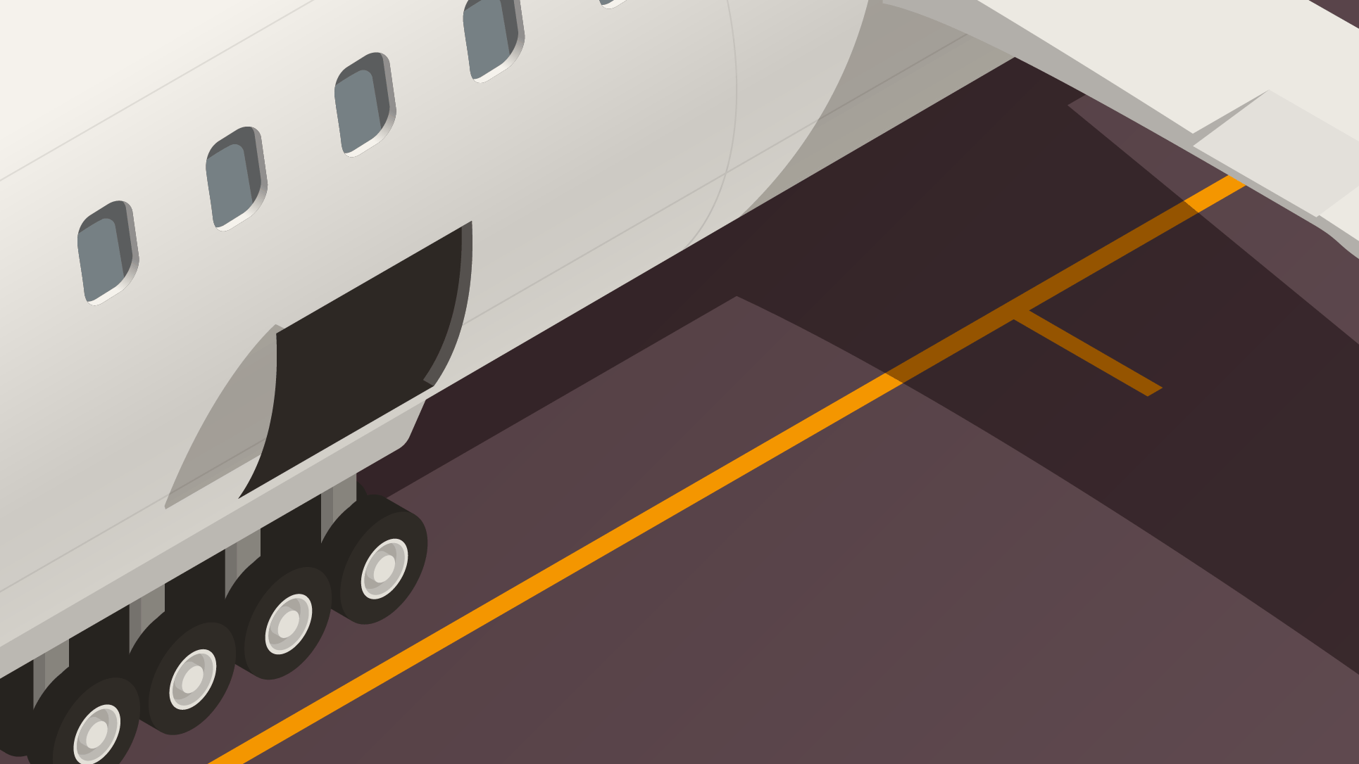

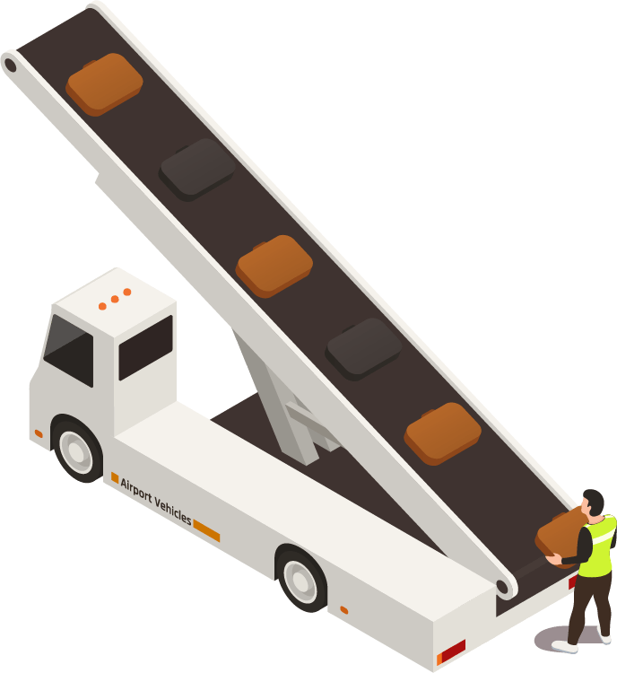
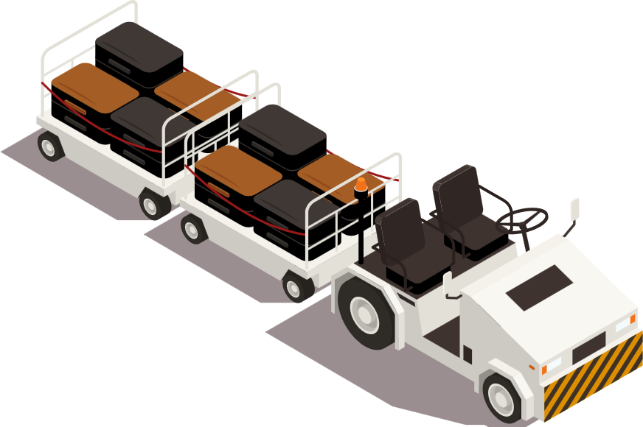
Luggage Tracking
Rain RFID tracking will enable airlines to monitor passengers' luggage in real time, drastically reducing the likelihood of lost baggage. This will not only enhance customer satisfaction but also cut operational costs significantly.

Slide 47
Safety and Compliance
Airlines will be able to use Rain RFID to efficiently track aircraft spare parts and seamlessly maintain detailed records of plane maintenance. This ensures better management, streamlined maintenance processes, and strict compliance with safety regulations.

Slide 48

Supply Chain Logistics

Slide 49

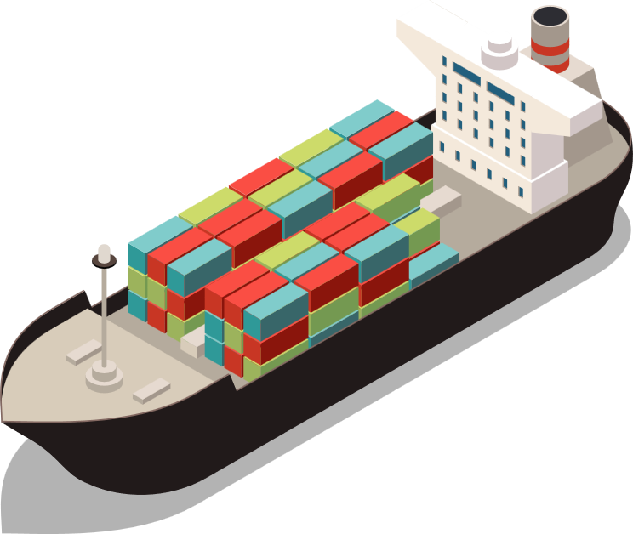
Real-Time Shipment Tracking
Have constant and accurate up to date information about the position of shipments at all times, through the use of Rain RFID scanners, ensuring an efficient real time tracking system!

Slide 50
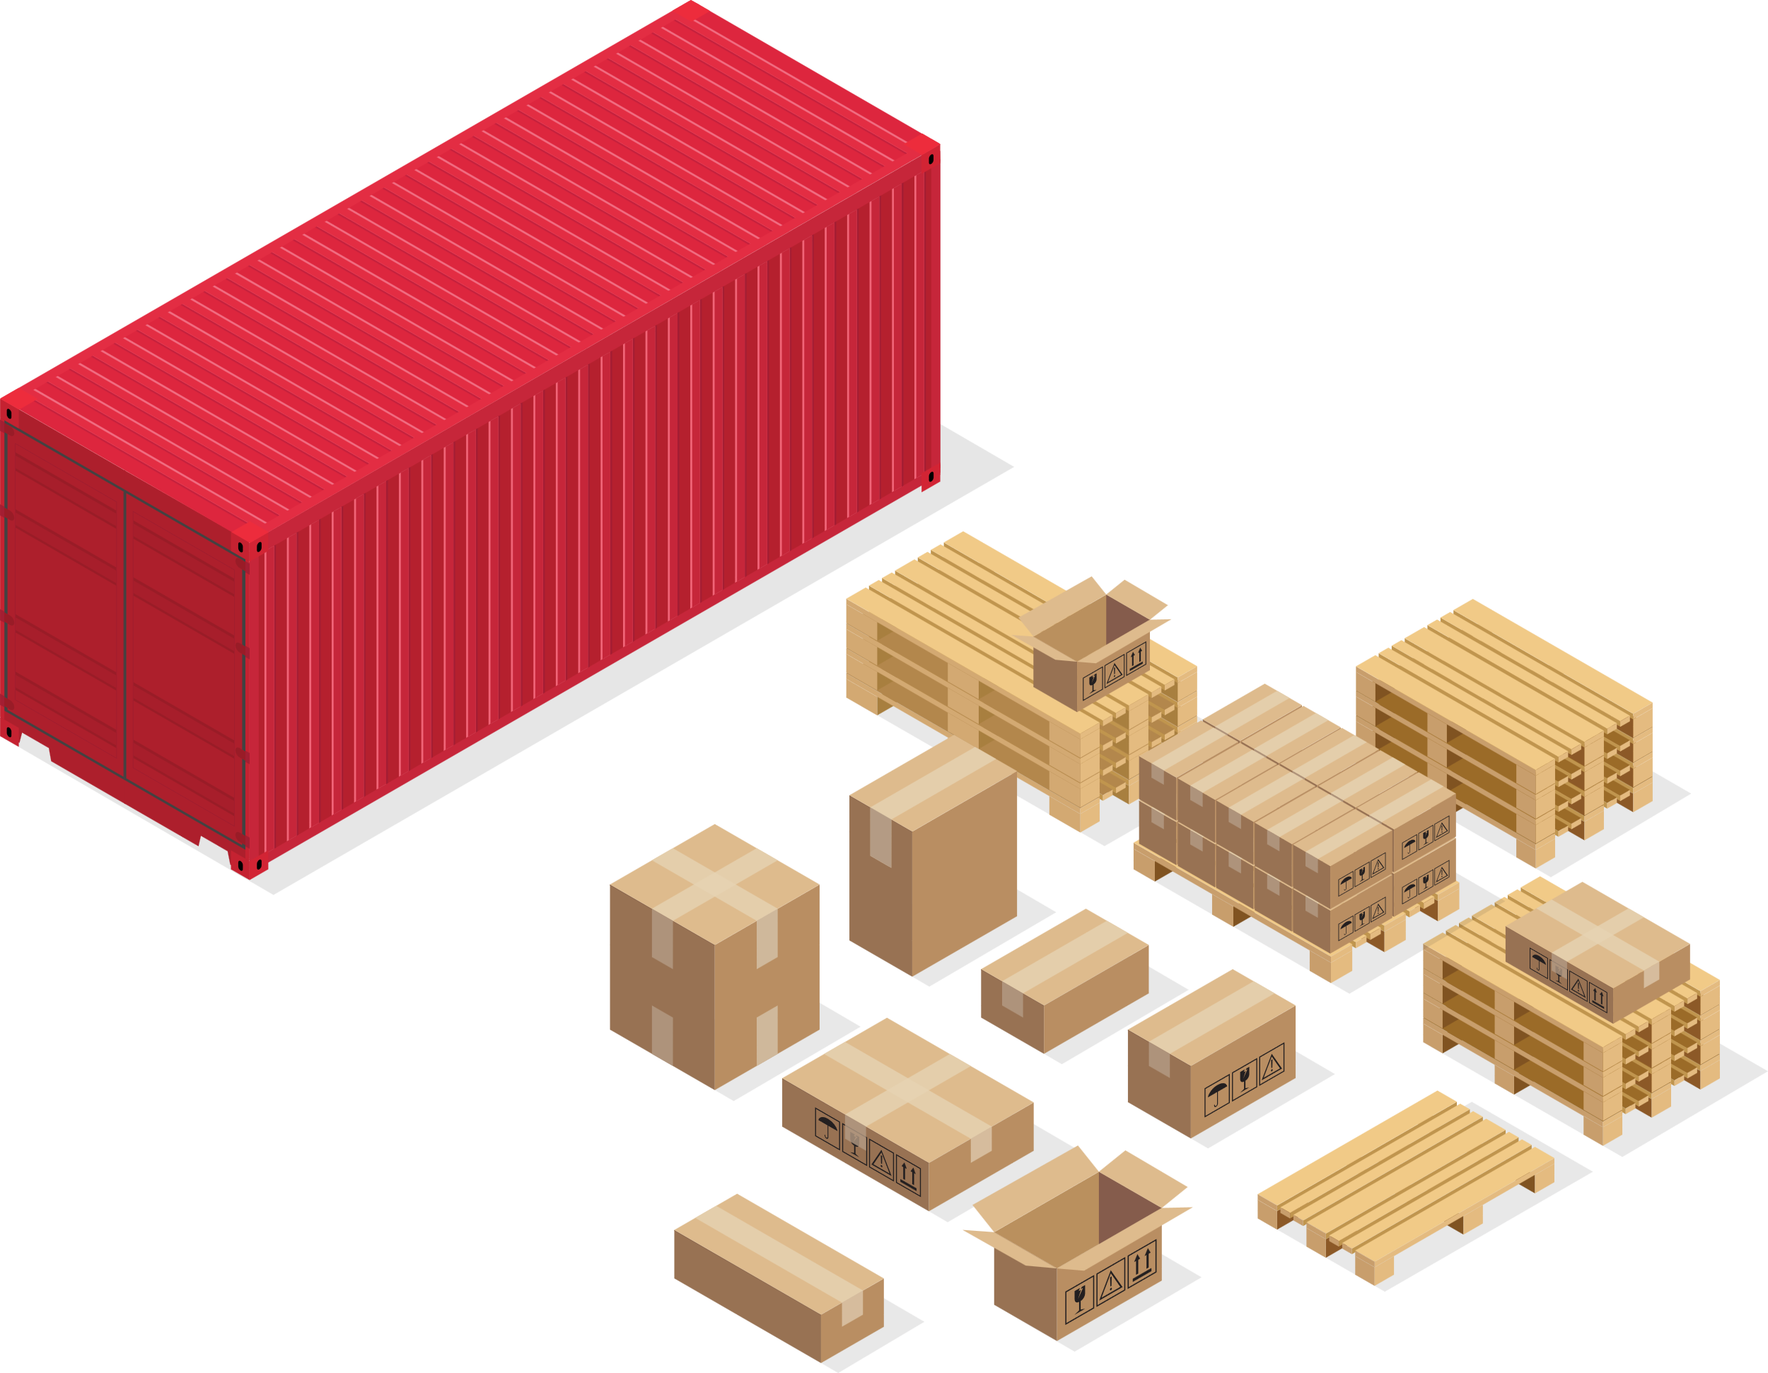

Warehouse Optimization
Managing goods in supply chains can be challenging, but implementing Rain RFID enables the development of fully automated inventory management systems. These systems streamline tracking, expedite tasks, and significantly reduce human errors. By automating processes such as inventory optimization and instant, real-time cycle counts, Rain RFID transforms efficiency and accuracy in supply chain operations.

Slide 51

Crowd Control

Slide 52










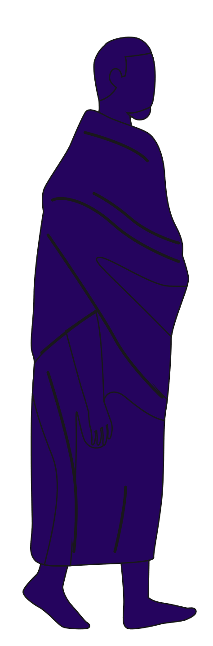
Automated Gates
Use RFID-enabled passes for concerts, exhibitions, and special events, to automate the security at entrance checkpoints, and also expedite the process for large crowded events

Slide 53



Crowd Management
Monitor and manage large crowds at events such as Hajj and Umrah, arguably the largest event in the world. Through smart Rain RFID systems, the entire process of handling pilgrims from point A to Z can be accelerated, ensuring both security and safety for all!

Slide 54

Banking & Finance

Slide 55


Floor Security
Access control can be established through different security clearances given to groups of stakeholders within the bank. High ranking stakeholders would be given higher security clearance, and through RFID managing access would be super simplified and automatic!

Slide 56

05
Reaching New Heights
Directions you could possibly take to elevate what’s currently possible to creating a brand new industry!
Enhanced Customer Experience
RFID-enabled tickets would provide seamless branch access and efficient queue management for banks, minimizing wait times and automatically assigning customers to available service representatives. This streamlined process would enhance efficiency, expedite customer service, and ensure a more satisfying banking experience.

Slide 57
05
Reaching New Heights
A possible path to creating a very lucrative Rain RFID future

Slide 58
The Issue With Rain RFID

Slide 59
Not Cheap Enough
Though Rain RFID does offer many more superior features than the barcode, one of the main issues is that it’s still not cost effective enough to completely eradicate the Barcode, as there are some industries which profit off very small margins.

Slide 60
$0.03
Is the average cost for the lowest price of Rain RFID tags out in the world wide market if purchased in bulk of (500,000) units. This price doesn’t include exporting costs!

Slide 61

1%
Too Expensive For Some
Though this price might seem attractive, in reality there are very big industries which still wouldn’t accept this price simply because their margin of profit is small! Here is an example

Slide 62
1%
Is the average retail margin of profit, for low value perishable goods, which is very small!
(Source: govividly)

Slide 63
1%
The Solution

Slide 64

Manufacturing Locally
A possible solution as to how the cost of Rain RFID tags can be reduced would be to manufacture them here locally. This would reduce the cost by just a bit to make them more accessible and reasonably affordable for some of cost conscious industries, however that won’t be enough

Slide 65

Government Support
Given Saudi Arabia's ambitious drive to establish a robust digital economy, presenting the government with the transformative potential of Rain RFID technology could yield significant benefits. By showcasing its capacity to revolutionize industries and enhance supply chain efficiency, the government may be incentivized to invest in the necessary infrastructure and provide subsidies to offset the costs locally by creating mega economies of scale!

Slide 66


Vision 2030 Alignment!
These measures could substantially lower the costs of local production, paving the way for widespread adoption across all sectors. This shift has the potential to unlock unprecedented opportunities, ultimately enabling Rain RFID technology to replace barcodes entirely and set a new standard for item-level tracking and identification.

Slide 67
A Potential Future

Slide 68
Retail (Case Study)

Slide 69






Removing The Barcode
As RFID tag prices become more affordable for the retail market, thanks to government subsidies, incentives, and local manufacturing, retailers will be encouraged to transition from traditional barcodes to RFID technology.

Slide 70
Precise Accuracy
Labeling low-value products with RFID tags which constitute the majority of a retailer’s inventory unlocks a range of advanced features and capabilities that were previously impossible with traditional barcode technology.

Slide 71


True Seamless Checkouts!
Checkouts would truly become seamless! As all consumers need to do is pack their items within their shopping carts, and either within the shopping cart or through an automated cashier, every single item would be scanned instantaneously, in less than a second

Slide 72
2min 52s
Based on a survey of retailers in the report, is the average time per customer spent in a cashier checking out. Consumers often perceive the wait time to be much longer
(Source: Opexlearning)

Slide 73
5s
Is how long it would take for both RFID to scan all items, and a contactless payment to be made, per customer.

Slide 74
98%
Reduction in the time spent for each customer!

Slide 75

Government Health Inspections
Retail stores have to comply with standards issued by the Saudi Food and Drug Authority to ensure that perishable foods such as yogurt aren’t kept in their inventory once expired, as serving them to the public can be severely dangerous to their health

Slide 76
Significant Fines!
Failure to comply with the SFDA would result in heavy fines to these retail companies if they fail to comply with the health and safety regulations for inventory management
(Source: SFDA.gov.sa)

Slide 77
50,000 SAR
Is how much retail companies would be fined if they were found to house expired food in their inventory, and this figure would double for repeat offenders!
(Source: SFDA.gov.sa)

Slide 78



For the Government
With Rain RFID technology, since every unit would be labelled, the inspectors wouldn’t need to manually inspect through every single item within a large inventory space, but rather with a scanner can condense the inspection time from several hours to minutes, and within those minutes, be able to identify if there are any expired or near expired goods

Slide 79
For the Retailers
On the other hand, retailers would benefit significantly, as they would have exact and precise numbers on which products they have currently, and which ones are out of stock, therefore enabling them to operate their inventory management at precise numbers, potentially being able to automate their entire processes

Slide 80

06
A lot of Data Collected!
The Big Data Industry
A brief introduction on how all the information collected through Rain RFID technology can be monetized in Saudi Arabia, unlocking a brand new industry!
Equipping each unit with an RFID tag that holds all relevant product information opens the door to an entirely new and potentially highly lucrative industry in Saudi Arabia. This innovation promises to revolutionize operations and drive significant economic growth.

Slide 81

06
The Big Data Industry
A brief introduction on how all the information collected through Rain RFID technology can be monetized in Saudi Arabia, unlocking a brand new industry!

Slide 82


What Is Big Data ?

Slide 83
What Is Big Data?
Big Data refers to extremely large and complex datasets that are difficult to process using traditional methods. It works by gathering vast amounts of information, organizing it, and analyzing it with advanced tools and algorithms to uncover patterns, trends, and insights. This enables better decision-making, improved efficiency, and predictions based on the data.

Slide 84
Collecting Data
Once RFID technology has entered multiple industries, and has become a national product, a lot of anonymous (non-PII) data would be collected, which once harvested, analyzed, and data mined can become an extremely lucrative commodity within the kingdom.

Slide 85
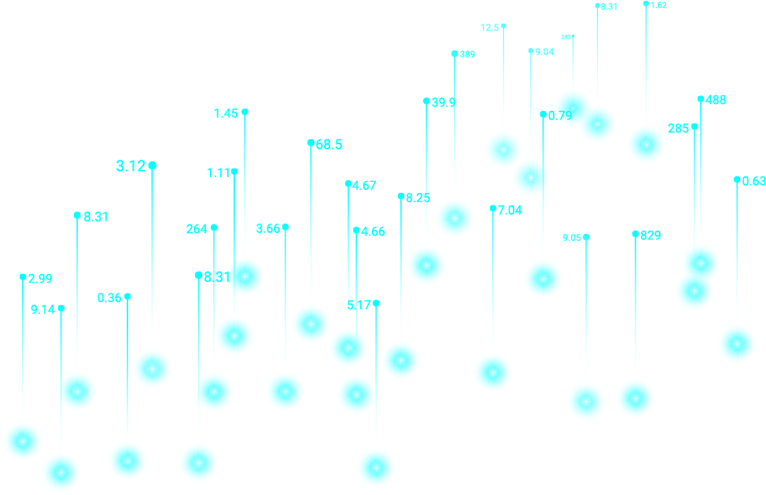
A New Industry
This data can then be used to provide consultations and services for many of the major companies in their respective industries, to better help them understand their market better, or gain insights in how to become much more efficient, etc, offering a service which no one else in the kingdom can provide to the following industries:
Retail
Aviation
Events & Crowd Management
Supply Chain & Logistics
Transportation
Healthcare

Slide 86
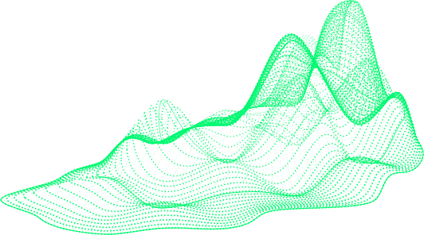
More Will Be Explored In The Upcoming
Business Incubation (Big Data Company)

Slide 87
Competitive Advantage
07
Early adoption ensures a leadership position in Saudi Arabia, and if we don’t do it, someone else will
Conclusion
Cost Efficiency
By acting now, Saudi Arabia can establish local manufacturing capabilities and significantly reduce dependency on imports.
A final bookend to this iteration of Technological Advancements
Catching Up To The Vision
Rain RFID perfectly aligns with the nation’s goals of modernizing infrastructure, enhancing public services, and creating a tech-driven economy.

Slide 88
Why Act Now?
Competitive Advantage
Early adoption ensures a leadership position in Saudi Arabia, and if we don’t do it, someone else will
Cost Efficiency
By acting now, Saudi Arabia can establish local manufacturing capabilities and significantly reduce dependency on imports.
Catching Up To The Vision
Rain RFID perfectly aligns with the nation’s goals of modernizing infrastructure, enhancing public services, and creating a tech-driven economy.

Slide 89

Rain RFID is more than a technology—it’s an innovative solution that redefines efficiency, precision, and scalability across multiple different industries.

Slide 90
With Saudi Arabia's strategic alignment to Vision 2030, this innovation can drive national progress, foster new industries, and position the Kingdom as a global leader in RFID technology.

Slide 91
Technological Developments
RAIN RFID Technology
A Possible Future with Limitless Applications!

