Slide 1

Who Are We?
Elevating Al Hilal
Innovative projects and ideas for a brighter future

Slide 2


Your Technical Arm
Who Are We?

Slide 3
Our Products?
Your Technical Arm
We specialize in providing high-quality, affordable, and flexible software solutions. Our expertise lies in the development of mobile applications, website development, product development services, and outsourced IT services.

Slide 4


Our Products?

Slide 5

For The Events
A platform for companies to manage crowds at events, a solution that works to simplify operations and provides comprehensive tools for event planning and organization

Slide 6
For Merchandising
Our Proposal
A platform for various services that allows suppliers to publish coverage of their products among stores and translate them into task units selected by freelancers.

Slide 7

Innovative Solutions
Our Proposal

Slide 8

Innovative Solutions
We’ve come up with a series of innovative solutions that we're confident you’ll value—ideas designed to set Al Hilal apart and distinguish it from other football clubs

Slide 9

















Innovative Solutions
A New Website!
E-Commerce Store!
Virtual Reality!
Ticketing System

Slide 10












A New Website!
"Our initial proposal is to create a brand-new website for Al Hilal, featuring a modern and streamlined structure to enhance user experience, making it simpler and more enjoyable to navigate

Slide 11





e-commerce Store
Our second proposition is to enhance the e-commerce store and make it more dynamic with an enhanced user experience.

Slide 12

Virtual Reality!
Our third proposal is to introduce a virtual reality system around the Kingdom’s Arena—an innovative approach for fans worldwide to immerse themselves in the football experience from any corner of the globe

Slide 13

A New Perspective!
How?
This allows fans worldwide to experience live matches with realism and live out the excitement of attending a live match.

Slide 14
How?

Slide 15



Cameras would be placed strategically around the stadium, simulating a 360 degree experience in both audio as well as visual.

Slide 16
Different cameras would be differently priced, depending on the angle and view that the cameras offer, therefore add an extra revenue stream for Al Hilal club.

Slide 17
Our Last Proposal
Finally

Slide 18
Our Last Proposal
Finally
The Biggest One

Slide 19
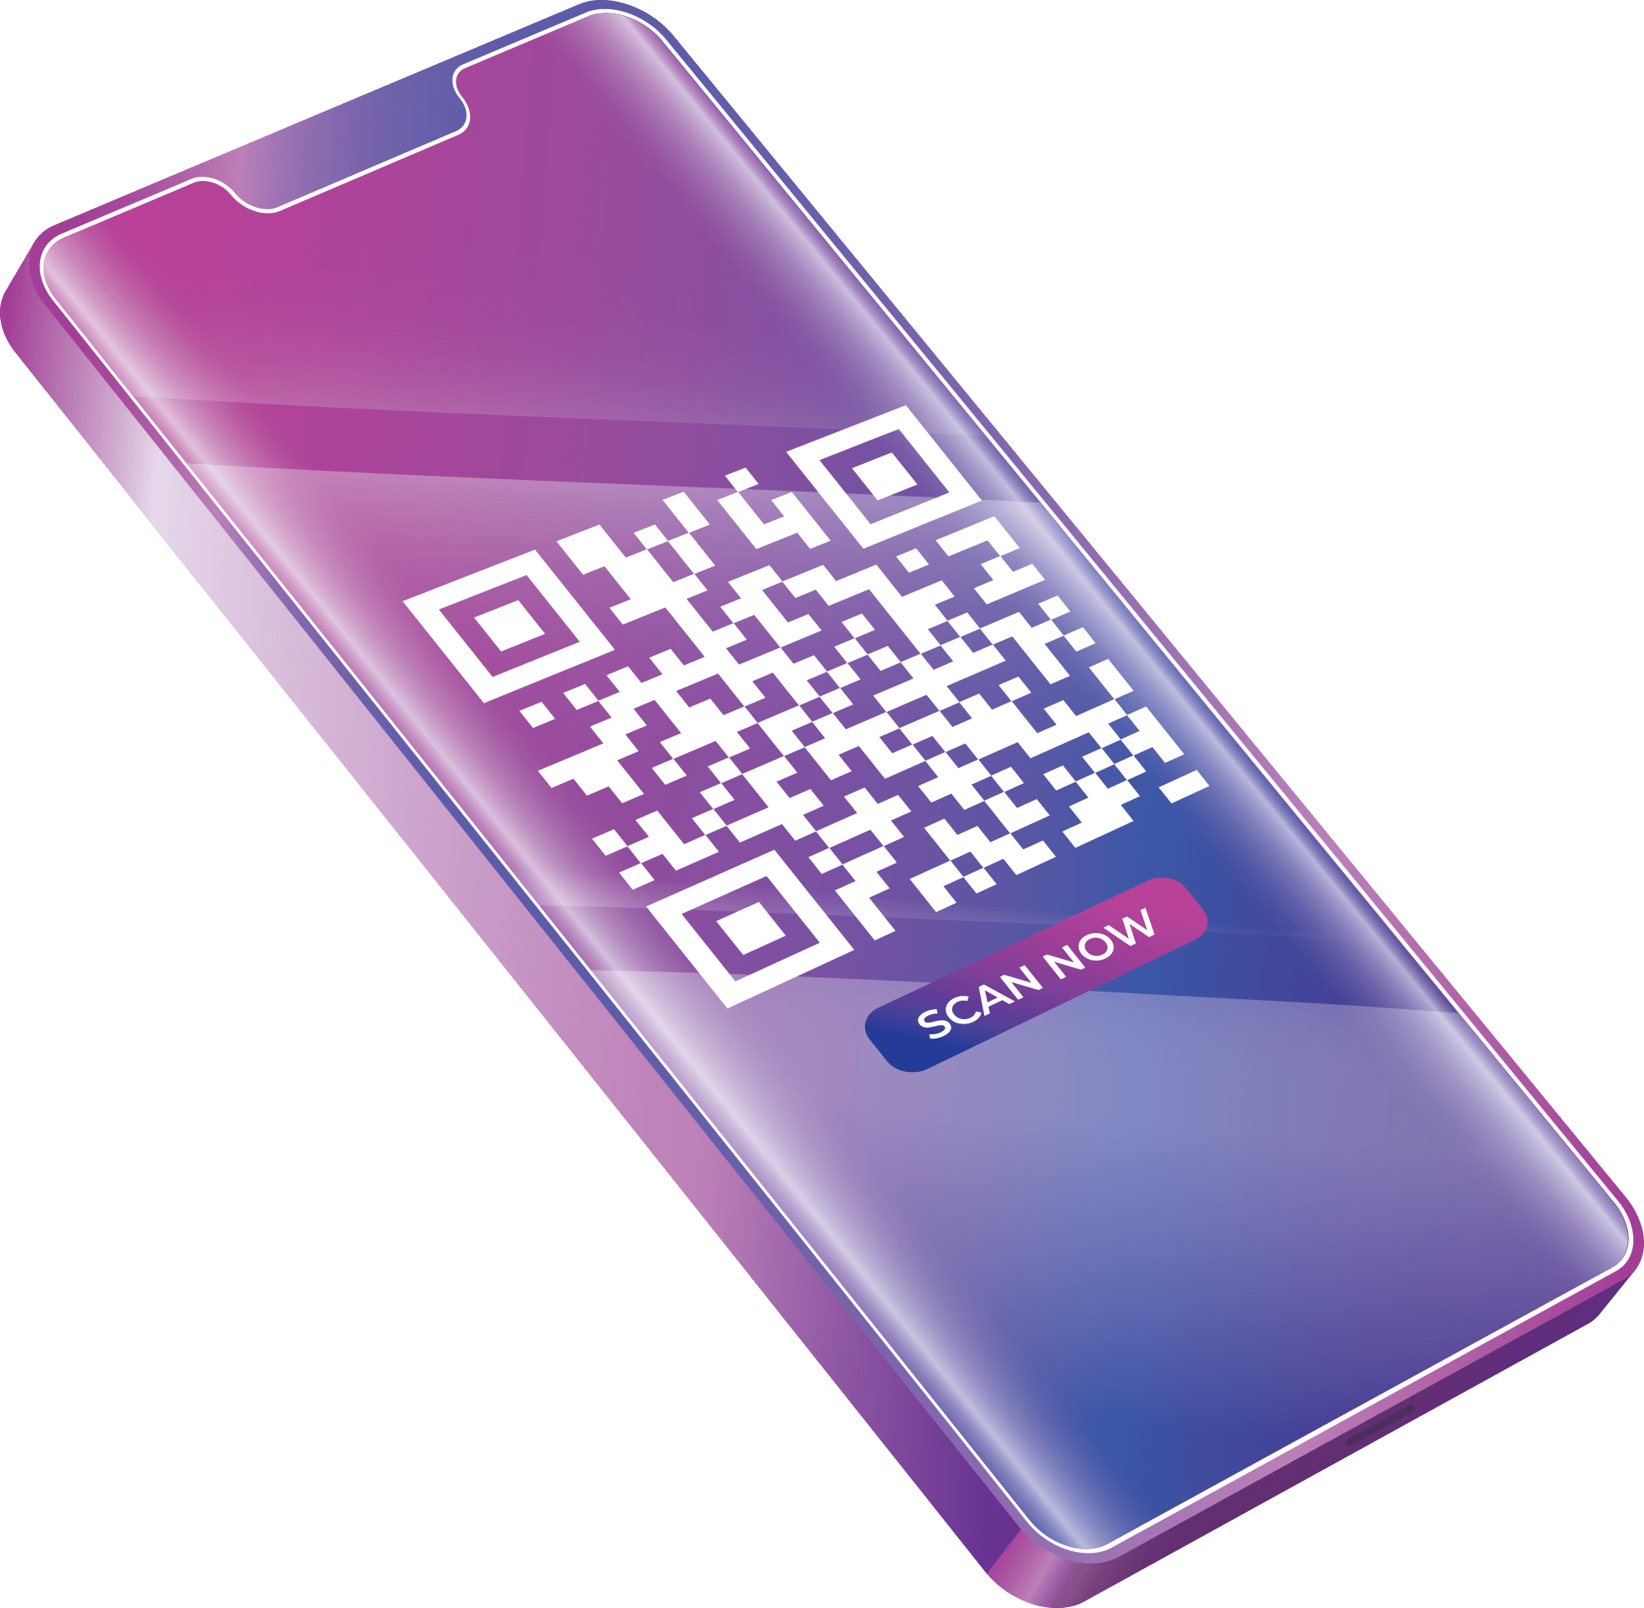

The Biggest One
Our Last Proposal

Slide 20

The Old Way
The Biggest One
The traditional method of producing and distributing tickets involved the use of QR codes. While effective in some aspects, we have identified certain Drawbacks associated with this approach.
Drawbacks

Slide 21
Drawbacks
Forgery
UX Issues
QR codes can be susceptible to forgery and duplication
Users would occasionally experience difficulties scanning due to factors such as poor lighting or damaged screens
The Biggest One
Screen Capture
Wait Time
Screenshots and photographs of QR codes can be taken and shared, therefore leading to unauthorized ticket sharing
QR scanning is considered to be a slow process when dealing with thousands of people

Slide 22


Forgery
UX Issues
QR codes can be susceptible to forgery and duplication
Users would occasionally experience difficulties scanning due to factors such as poor lighting or damaged screens
The New Way
Screen Capture
Wait Time
Screenshots and photographs of QR codes can be taken and shared, therefore leading to unauthorized ticket sharing
QR scanning is considered to be a slow process when dealing with thousands of people

Slide 23
NFC
RFID

Slide 24

NFC
The Biggest One
NFC (Near Field Communication) is a short-range wireless technology for quick data exchange between devices in close proximity, commonly used for contactless payments, ticketing, and data transfer.

Slide 25



The idea now is once a user taps their phone onto the NFC reader, the system would automatically check their ticket through NFC technology without the need of a QR code

Slide 26

And almost instantaneously the gates would open confirming that the user is allowed access to the stadium very quickly

Slide 27
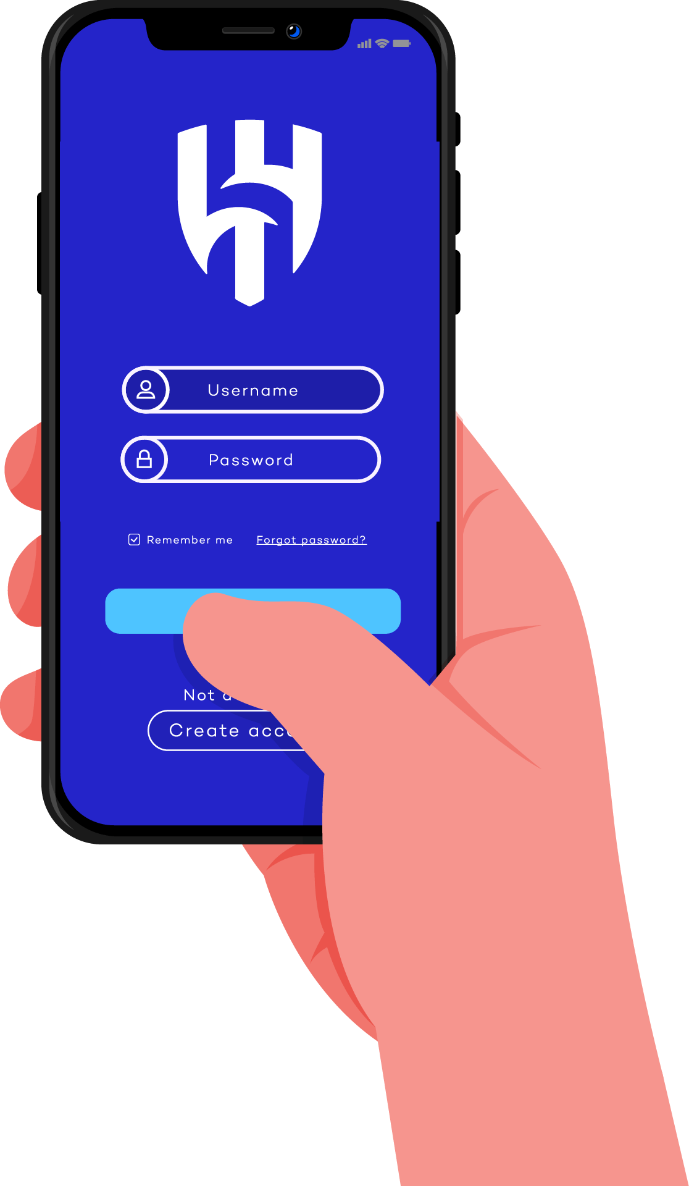
The Al Hilal App

Slide 28
The Al Hilal App
The Registration Process
We propose to develop the Al Hilal Application serving as a platform for users to conveniently store and utilize their e-tickets, leveraging the capabilities of NFC technology

Slide 29
The Registration Process

Slide 30
Pre-requisites for registering
National ID
Phone Number

Slide 31
Pre-requisites for registering
Features
These are the chosen pre-requisites is to prevent application misuse as well as further ease the process of booking tickets and authenticating user information
National ID
Phone Number

Slide 32
Features

Slide 33



Easy Booking
Book tickets through the application or website for yourself and others with ease since accounts will have accurate information about you taken from Absher, booking can be as simple and fast as a press of a single button

Slide 34




Transfer Tickets Securely
Transfer tickets to others by using their phone numbers, and if they have the application, they will automatically receive the transferred tickets.

Slide 35
Transfer Tickets Securely
Another option is to be able to transfer tickets to nearby people by simply tapping both the sender and the receiver’s phone and the NFC readers would perform the ticket transfer securely.

Slide 36








Transfer Tickets Securely
This completely eliminates the dark market and ensures a secure distributed system of transferring tickets

Slide 37
Memberships
Link pre-existing memberships to your account, or potentially sign up for one as new members, to unlock many benefits.

Slide 38
Ideas For Benefits

Slide 39


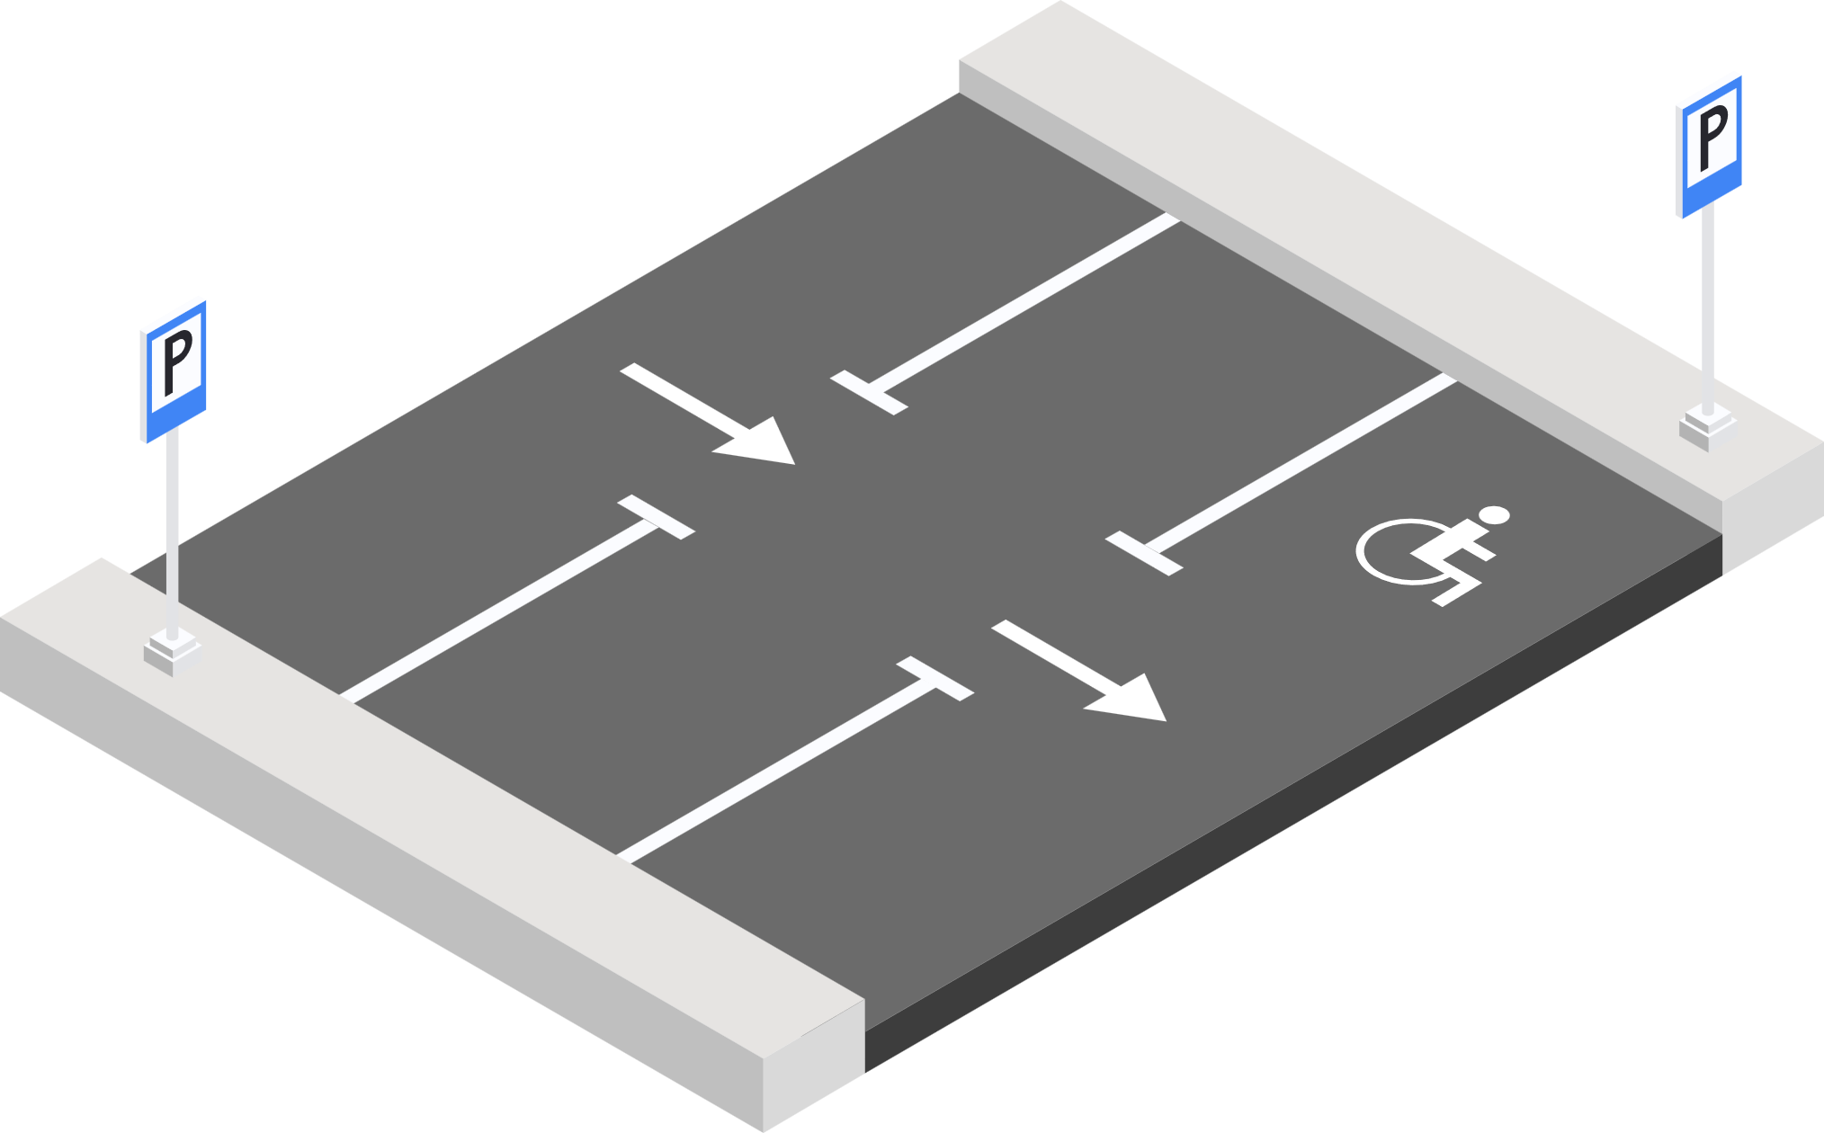
Priority Booking
Members would have the advantage of being able to book one or two days before non-members.

Slide 40
Reserved Parking
If existing members book early, they would also be guaranteed a parking in the stadium parking space. The parking space selected would be random and the next available one.

Slide 41
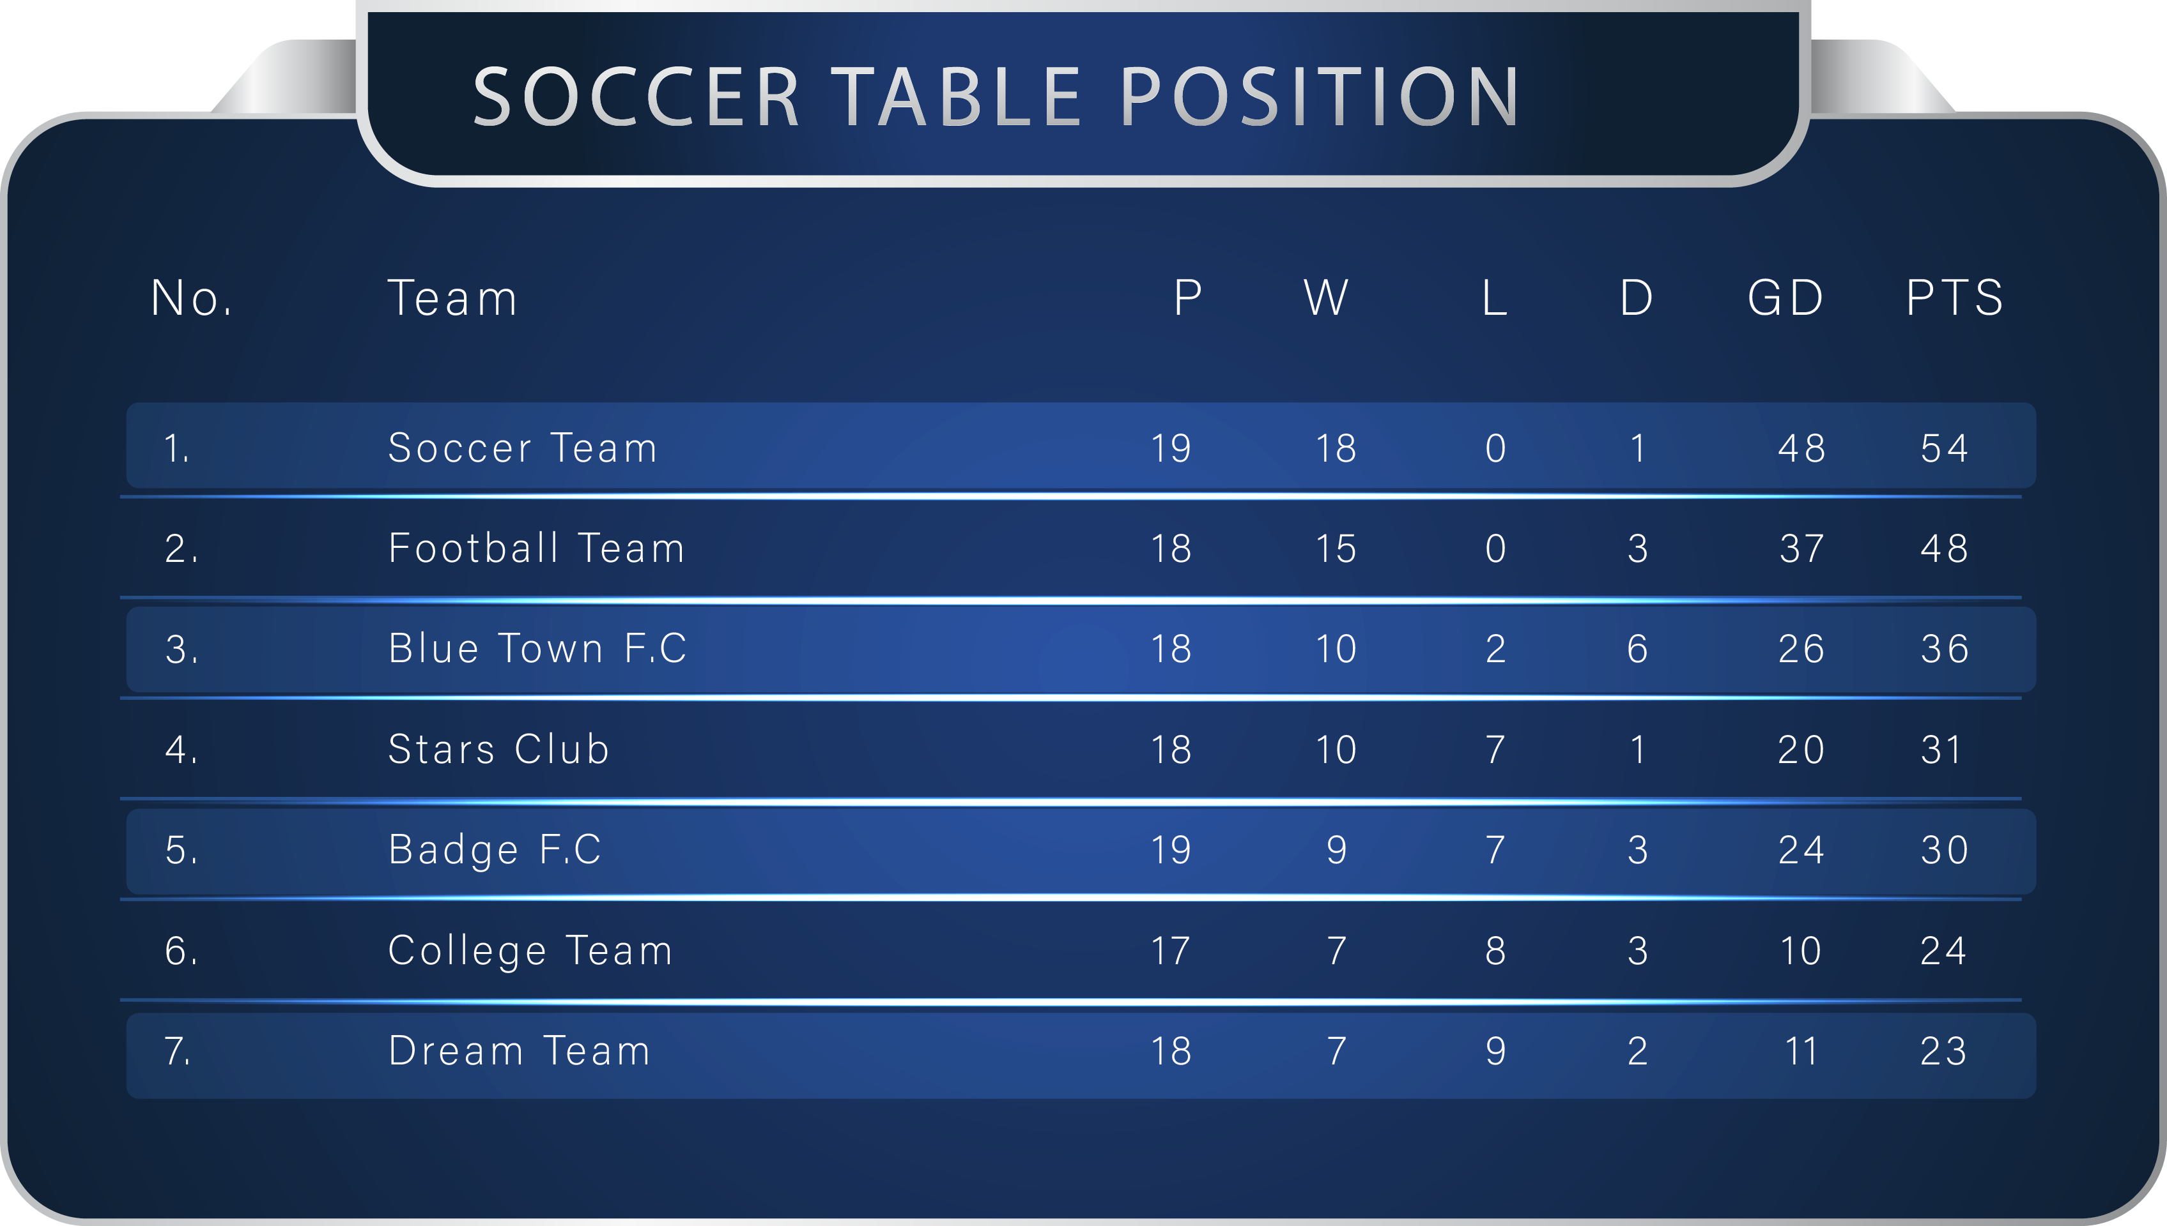


Other Features

Slide 42




Live Match Updates
Users would always be ontop of the game wherever they are, and can keep track of the progress of the match live and view live results of the match they’ve attended or whatever match is currently taking place in the stadium

Slide 43










Surveys & Feedback
Users can post their feedback on each football game, and comment on potential improvements that can be done to further enhance the football experience, as well as act as a channel for Al Hilal to send surveys to Al Hilal users.

Slide 44
Points Based System
The more a user attend football matches in the Kingdom’s Arena, the more points they gain, this would further user engagement as these points could then be redeemed for rewards which would encourage further user engagement.

Slide 45
Points Based System
To increase the referral rate, users can gain points through a special referral system, the more friends sign up through them, the more points the user gains.

Slide 46






Points Based System
500
750
1000
1500
3000
7000
Store Items
25% off
50% off
100% off
Golden Ticket
Meet a Player
Store items which are equivalent to 500 points can be bought for free
Discount applies to the next match
Discount applies to the next match
Next match you get a free standard ticket
You get a free golden ticket
Have an opportunity to meet a player of your choosing, different players require different points

Slide 47
Points Based System
Fan Leaderboards
Have a leaderboard of the top 10 most engaged fans by showing their total number of points, this leadership board would help Al Hilal know who are they’re most engaged fans and can open up opportunities for these users and lead to direct interactions

Slide 48



Phase 2

Slide 49

UHR RFID
UHF RFID technology uses ultra-high frequency radio waves to wirelessly identify and track objects or individuals by reading unique identifiers stored on RFID tags. It is known for its longer read ranges

Slide 50
Tagged Bracelets
Users simply need to pay a premium and purchase these bracelets once

Slide 51
Tagged Bracelets
With the idea of bracelets in the design of the user’s favorite football team, the user would be able to link their account with this bracelet therefore unlocking additional features and benefits

Slide 52
Features

Slide 53







Express Entrance
With RFID tags, the users wouldn’t need to tap or interact with anything, all they need to do is simply walk towards an entrance and enter the stadium, therefore increase the crowd management efficiency like never before!

Slide 54


Additional Points
Users who attend the stadium with their RFID bracelets would potentially gain additional points for every match, therefore getting rewards much more quickly than those who don’t have them

Slide 55



Enhanced Security
Al Hilal would have real-time accurate tracking of everyone who is in the football stadium, therefore being able to identify culprits very quickly and easily track them down

Slide 56
Accurate Statistics
Al Hilal would have accurate real time statistics on all things related to crowd control, therefore bringing them very accurate metrics which can be used to further enhance their decision making

Slide 57
Thank You

